Slide 1
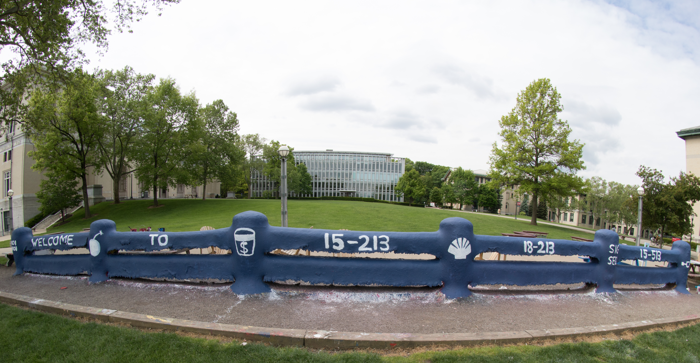

Slide 2
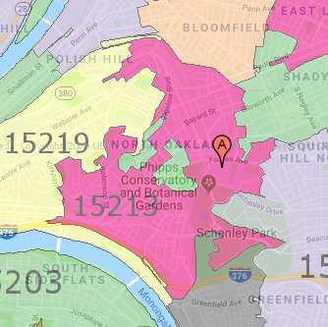
Course Overview 15-213/18-213/15-513/14-513: Introduction to Computer Systems 1st Lecture, Aug 28, 2018
Instructors:
Randy Bryant
Phil Gibbons
Brian Railing
Greg Kesden
The course that gives CMU its “Zip”!

Slide 3
Overview
Big Picture
Course theme
Five realities
How the course fits into the CS/ECE/INI curriculum
Academic integrity
Logistics and Policies

Slide 4
The Big Picture

Slide 5
Course Theme: (Systems) Knowledge is Power!
Systems Knowledge
How hardware (processors, memories, disk drives, network infrastructure) plus software (operating systems, compilers, libraries, network protocols) combine to support the execution of application programs
How you as a programmer can best use these resources
Useful outcomes from taking 213/513
Become more effective programmers
Able to find and eliminate bugs efficiently
Able to understand and tune for program performance
Prepare for later “systems” classes in CS, ECE, INI, ...
Compilers, Operating Systems, Networks, Computer Architecture, Embedded Systems, Storage Systems, Computer Security, etc.

Slide 6
It’s Important to Understand How Things Work
Why do I need to know this stuff?
Abstraction is good, but don’t forget reality
Most CS courses emphasize abstraction
(CE courses less so)
Abstract data types
Asymptotic analysis
These abstractions have limits
Especially in the presence of bugs
Need to understand details of underlying implementations
Sometimes the abstract interfaces don’t provide the level of control or performance you need

Slide 7
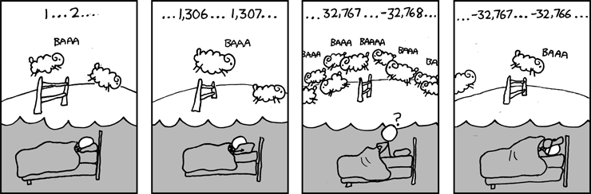
Great Reality #1: Ints are not Integers, Floats are not Reals
Example 1: Is x² ≥ 0?
Float’s: Yes!
Int’s:
40000 * 40000 --> 1600000000
50000 * 50000 --> ?
Example 2: Is (x + y) + z = x + (y + z)?
Unsigned & Signed Int’s: Yes!
Float’s:
(1e20 + -1e20) + 3.14 --> 3.14
1e20 + (-1e20 + 3.14) --> ??
Source: xkcd.com/571

Slide 8
Computer Arithmetic
Does not generate random values
Arithmetic operations have important mathematical properties
Cannot assume all “usual” mathematical properties
Due to finiteness of representations
Integer operations satisfy “ring” properties
Commutativity, associativity, distributivity
Floating point operations satisfy “ordering” properties
Monotonicity, values of signs
Observation
Need to understand which abstractions apply in which contexts
Important issues for compiler writers and serious application programmers

Slide 9
Great Reality #2: You’ve Got to Know Assembly
Chances are, you’ll never write programs in assembly
Compilers are much better & more patient than you are
But: Understanding assembly is key to machine-level execution model
Behavior of programs in presence of bugs
High-level language models break down
Tuning program performance
Understand optimizations done / not done by the compiler
Understanding sources of program inefficiency
Implementing system software
Compiler has machine code as target
Operating systems must manage process state
Creating / fighting malware
x86 assembly is the language of choice!

Slide 10
Great Reality #3: Memory Matters Random Access Memory Is an Unphysical Abstraction
Memory is not unbounded
It must be allocated and managed
Many applications are memory dominated
Memory referencing bugs especially pernicious
Effects are distant in both time and space
Memory performance is not uniform
Cache and virtual memory effects can greatly affect program performance
Adapting program to characteristics of memory system can lead to major speed improvements

Slide 11
Memory Referencing Bug Example
typedef struct {
int a[2];
double d;
} struct_t;
double fun(int i) {
volatile struct_t s;
s.d = 3.14;
s.a[i] = 1073741824; /* Possibly out of bounds */
return s.d;
}
fun(0) --> 3.14
fun(1) --> 3.14
fun(2) --> 3.1399998664856
fun(3) --> 2.00000061035156
fun(4) --> 3.14
fun(6) --> Segmentation fault
Result is system specific

Slide 12
Memory Referencing Bug Example
typedef struct {
int a[2];
double d;
} struct_t;
fun(0) --> 3.14
fun(1) --> 3.14
fun(2) --> 3.1399998664856
fun(3) --> 2.00000061035156
fun(4) --> 3.14
fun(6) --> Segmentation fault
Explanation:
Critical State | 6
? | 5
? | 4
d7 ... d4 | 3
d3 ... d0 | 2
a[1] | 1
a[0] | 0
Location accessed by fun(i)
struct_t

Slide 13
Memory Referencing Errors
C and C++ do not provide any memory protection
Out of bounds array references
Invalid pointer values
Abuses of malloc/free
Can lead to nasty bugs
Whether or not bug has any effect depends on system and compiler
Action at a distance
Corrupted object logically unrelated to one being accessed
Effect of bug may be first observed long after it is generated
How can I deal with this?
Program in Java, Ruby, Python, ML, …
Understand what possible interactions may occur
Use or develop tools to detect referencing errors (e.g. Valgrind)

Slide 14
Great Reality #4: There’s more to performance than asymptotic complexity
Constant factors matter too!
And even exact op count does not predict performance
Easily see 10:1 performance range depending on how code written
Must optimize at multiple levels: algorithm, data representations, procedures, and loops
Must understand system to optimize performance
How programs compiled and executed
How to measure program performance and identify bottlenecks
How to improve performance without destroying code modularity and generality

Slide 15
Memory System Performance Example
void copyij(int src[2048][2048],
int dst[2048][2048])
{
int i,j;
for (i = 0; i < 2048; i++)
for (j = 0; j < 2048; j++)
dst[i][j] = src[i][j];
}
void copyji(int src[2048][2048],
int dst[2048][2048])
{
int i,j;
for (j = 0; j < 2048; j++)
for (i = 0; i < 2048; i++)
dst[i][j] = src[i][j];
}
4.3ms
81.8ms
2.0 GHz Intel Core i7 Haswell
Hierarchical memory organization
Performance depends on access patterns
Including how step through multi-dimensional array

Slide 16
Why The Performance Differs
copyij
copyji

Slide 17
Great Reality #5: Computers do more than execute programs
They need to get data in and out
I/O system critical to program reliability and performance
They communicate with each other over networks
Many system-level issues arise in presence of network
Concurrent operations by autonomous processes
Coping with unreliable media
Cross platform compatibility
Complex performance issues

Slide 18
Course Perspective
Most Systems Courses are Builder-Centric
Computer Architecture
Design pipelined processor in Verilog
Operating Systems
Implement sample portions of operating system
Compilers
Write compiler for simple language
Networking
Implement and simulate network protocols

Slide 19
Course Perspective (Cont.)
Our Course is Programmer-Centric
By knowing more about the underlying system, you can be more effective as a programmer
Enable you to
Write programs that are more reliable and efficient
Incorporate features that require hooks into OS
E.g., concurrency, signal handlers
Cover material in this course that you won’t see elsewhere
Not just a course for dedicated hackers
We bring out the hidden hacker in everyone!

Slide 20
Role within CS/ECE Curriculum
CS 122
Imperative
Programming
Foundation of Computer Systems Underlying principles for hardware, software, and networking
213/513
ECE Systems
18-349 Computer Security
18-349 Intro to Embedded Systems
18-441 Computer Networks
18-447 Computer Architecture
18-452 Wireless Networking
18-451 Cyberphysical Systems
CS Systems
15-319 Cloud Computing
15-330 Computer Security
15-410 Operating Systems
15-411 Compiler Design
15-415 Database Applications
15-418 Parallel Computing
15-440 Distributed Systems
15-441 Computer Networks
15-445 Database Systems
CS Graphics
15-462 Computer Graphics
15-463 Comp. Photography

Slide 21
Academic Integrity
Please pay close attention, especially if this is your first semester at CMU
Carefully review policy:
http://www.cs.cmu.edu/afs/cs.cmu.edu/academic/class/15213-f18/www/academicintegrity.html

Slide 22
Cheating/Plagiarism: Description
Unauthorized use of information
Borrowing code: by copying, retyping, looking at a file
Describing: verbal description of code from one person to another.
Searching the Web for solutions
Copying code from a previous course or online solution
Reusing your code from a previous semester (here or elsewhere)
Arrange meeting with instructor before reusing your old solutions

Slide 23
Cheating/Plagiarism: Description (cont.)
Unauthorized supplying of information
Providing copy: Giving a copy of a file to someone
Providing access:
Putting material in unprotected directory
Putting material in unprotected code repository (e.g., Github)
Or, letting protections expire
Applies to this term and the future
There is no statute of limitations for academic integrity violations
Collaborations beyond high-level, strategic advice
Anything more than block diagram or a few words
Code / pseudo-code is NOT high level
Coaching, arranging blocks of allowed code is NOT high level
Code-level debugging is NOT high level

Slide 24
Cheating/Plagiarism: Description
What is NOT cheating?
Explaining how to use systems or tools
Helping others with high-level design issues
High means very high
Using code supplied by us
Starter code, class examples
Using code from the CS:APP web site
Attribution Requirements
Starter code: No
Other allowed code (course, CS:APP): Yes
Indicate source, beginning and end

Slide 25
Cheating: Consequences
Penalty for cheating:
Best case: -100% for assignment
You would be better off to turn in nothing
Worst case: Removal from course with failing grade
This is the default
Permanent mark on your record
Loss of respect by you, the instructors and your colleagues
If you do cheat – come clean asap!
Detection of cheating:
We have sophisticated tools for detecting code plagiarism
In Fall 2015, 20 students were caught cheating and failed the course.
Some were expelled from the University
In January 2016, 11 students were penalized for cheating violations that occurred as far back as Spring 2014.
Don’t do it!
Manage your time carefully
Ask the staff for help when you get stuck

Slide 26
Some Concrete Examples:
This is Cheating:
Searching the internet with the phrase 15-213, 15213, 213, 18213, malloclab, etc.
That’s right, just entering it in a search engine
Looking at someone’s code on the computer next to yours
Giving your code to someone else, now or in the future
Posting your code in a publicly accessible place on the Internet, now or in the future
Hacking the course infrastructure
This is OK (and encouraged):
Googling a man page for fputs
Asking a friend for help with gdb (but not with your code)
Asking a TA or course instructor for help, showing them your code, …
Using code examples from book (with attribution)
Talking about a (high-level) approach to the lab with a classmate

Slide 27
How it Feels: Student and Instructor
Fred is desperate. He can’t get his code to work and the deadline is drawing near. In panic and frustration, he searches the web and finds a solution posted by a student at U. Oklahoma on Github. He carefully strips out the comments and inserts his own. He changes the names of the variables and functions. Phew! Got it done!
The course staff run checking tools that compare all submitted solutions to the solutions from this and other semesters, along with ones that are on the Web.
Remember: We are as good at web searching as you are
Meanwhile, Fred has had an uneasy feeling: Will I get away with it? Why does my conscience bother me?
Fred gets email from an instructor: “Please see me tomorrow at 9:30 am.”
Fred does not sleep well that night

Slide 28
How it Feels: Student and Instructor (cont.)
The instructor feels frustrated. His job is to help students learn, not to be police. Every hour he spends looking at code for cheating is time that he cannot spend providing help to students. But, these cases can’t be overlooked
At the meeting:
Instructor: “Explain why your code looks so much like the code on Github.”
Fred: “Gee, I don’t know. I guess all solutions look pretty much alike.”
Instructor: “I don’t believe you. I am going to file an academic integrity violation.”
Fred will have the right to appeal, but the instructor does not need him to admit his guilt in order to penalize him.
Consequences
Fred may (most likely) will be given a failing grade for the course
Fred will be reported to the university
A second AIV will lead to a disciplinary hearing
Fred will go through the rest of his life carrying a burden of shame
The instructor will experience a combination of betrayal and distress

Slide 29
Why It’s a Big Deal
This material is best learned by doing
Even though that can, at times, be difficult and frustrating
Starting with a copy of a program and then tweaking it is very different from writing from scratch
Planning, designing, organizing a program are important skills
We are the gateway to other system courses
Want to make sure everyone completing the course has mastered the material
Industry appreciates the value of this course
We want to make sure anyone claiming to have taken the course is prepared for the real world
Working in Teams and Collaboration is an Important Skill
But only if team members have solid foundations
This course is about foundations, not teamwork

Slide 30
Version Control: Your Good Friend
We will be using Github Education
Assignment distribution
Your workspace
Use your course account, rather than a personal Github account
Use as you should a version server
Commit early and often
Document your commits
Missing GIT history can count against you
How we use it
If we suspect academic integrity issues, we can see if commit history looks reasonable.
Steady, consistent, and sustained work
It can serve as your character witness

Slide 31
How to Avoid AIVs
Start early
Don’t rely on marathon programming sessions
Your brain works better in small bursts of activity
Ideas / solutions will come to mind while you’re doing other things
Plan for stumbling blocks
Assignment is harder than you expected
Code doesn’t work
Bugs hard to track down
Life gets in the way
Minor health issues
Unanticipated events

Slide 32
Logistics

Slide 33


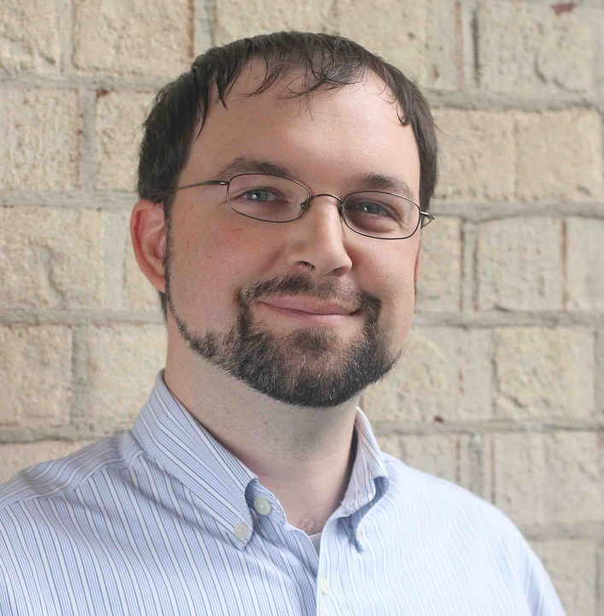
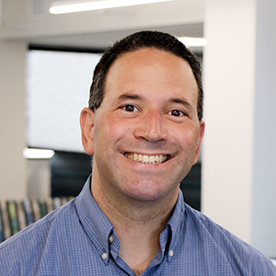
Instructors
Carnegie Mellon
Randy Bryant
Phil Gibbons
15-213/18-213
Brian Railing
Greg Kesden
14-513
15-513

Slide 34
15-213/18-213, 14-513, and 15-513
Carnegie Mellon
15-213/18-213
Only undergraduates
Live lectures
In-class quizzes via Canvas
Recitations
14-513
INI Masters students
Live + live-streamed lectures
15-513
Other Masters students
Lectures by video
Welcome to attend live lectures (213 or 14-513) when space is available
Welcome to make use of live-streamed lectures from 14-513
Everything else is the same for all the courses

Slide 35
Live-Streamed Lecture Availability
Optional virtual lecture attendance via BlueJeans
Lecture (T Th): 12:00 – 1:20 pm
Recitation (M): 11:30-12:20, 12:30-1:20, or 1:30-2:20 pm
Separate video and slide streams
Can adjust how much real-estate for each
Can ask questions via push-to-talk
Have your video pop up when you do, or just an icon
Links
Lecture: https://bluejeans.com/866858530)
Recitation: https://bluejeans.com/356748408
Socrative: https://api.socrative.com/rc/FatLaX (Will discuss during Lecture 1)
Etiquette: Join with audio off and push-to-talk
Joining microphone-on distracts everyone with background noise.

Slide 36
Textbooks
Randal E. Bryant and David R. O’Hallaron,
Computer Systems: A Programmer’s Perspective, Third Edition (CS:APP3e), Pearson, 2016
http://csapp.cs.cmu.edu
This book really matters for the course!
How to solve labs
Practice problems typical of exam problems
Electronic editions available (Don’t get paperback version!)
On reserve in Sorrells Library
Brian Kernighan and Dennis Ritchie,
The C Programming Language, Second Edition, Prentice Hall, 1988
Still the best book about C, from the originators
Even though it does not cover more recent extensions of C
On reserve in Sorrells Library

Slide 37
Course Components
Lectures
Higher level concepts
15-213/18-213: Will run in-class quizzes via Canvas
Your performance could tilt you to a higher grade if it’s a borderline case.
Labs (8)
The heart of the course
1-2+ weeks each
Provide in-depth understanding of an aspect of systems
Programming and measurement
Exams (midterm + final)
Test your understanding of concepts & mathematical principles

Slide 38
Getting Help
Carnegie Mellon
Class Web pages:
http://www.cs.cmu.edu/~213
https://www.andrew.cmu.edu/course/14-513-f18/
Complete schedule of lectures, exams, and assignments
Copies of lectures, assignments, exams, solutions
FAQ
Piazza
Best place for questions about assignments
By default, your posts will be private
We will fill the FAQ and Piazza with answers to common questions
Canvas (15-213, 18-213)
15/18-213 We will use Canvas for in-class quizzes

Slide 39
Getting Help
Carnegie Mellon
Email
Send email to individual instructors or TAs only to schedule appointments
Office hours (starting Tue Sep 5):
TAs: SMTWR, 5:00–9:00pm, WeH 5207 [Thursdays are 5:30–9:00]
Instructors: See course home page
Walk-in Tutoring
Details TBA. Will put information on class webpage.
1:1 Appointments
You can schedule 1:1 appointments with any of the teaching staff

Slide 40
Policies: Labs And Exams
Work groups
You must work alone on all lab assignments
Handins
Labs due at 11:59pm
Electronic handins using Autolab (no exceptions!)
Exams
Exams will be online in network-isolated clusters
Held over multiple days. Self-scheduled; just sign up!
Appealing grades
Exams: Request via exam server
Assignments: via detailed private post to Piazza within 7 days of completion of grading
Follow formal procedure described in syllabus

Slide 41
Facilities
Labs will use the Intel Computer Systems Cluster
The “shark machines”
linux> ssh shark.ics.cs.cmu.edu
21 servers donated by Intel for 213/513
10 student machines (for student logins)
1 head node (for instructor logins)
10 grading machines (for autograding)
Each server: Intel Core i7: 8 Nehalem cores, 32 GB DRAM, RHEL 6.1
Rack-mounted in Gates machine room
Login using your Andrew ID and password

Slide 42
Timeliness
Grace days
5 grace days for the semester
Limit of 0, 1, or 2 grace days per lab used automatically
Covers scheduling crunch, out-of-town trips, illnesses, minor setbacks
Lateness penalties
Once grace day(s) used up, get penalized 15% per day
No handins later than 3 days after due date
Catastrophic events
Major illness, death in family, …
Formulate a plan (with your academic advisor) to get back on track
Advice
Once you start running late, it’s really hard to catch up
Try to save your grace days until the last few labs

Slide 43
Other Rules of the Lecture Hall
Laptops: permitted
Electronic communications: forbidden
No email, instant messaging, cell phone calls, etc
Presence in lectures (213): strongly encouraged (and can count in your favor for borderline grades)
No recordings of ANY KIND

Slide 44
Policies: Grading
Exams (50%): midterm (20%), final (30%)
Labs (50%): weighted according to effort
Final grades based on a straight scale (90/80/70/60) with a small amount of curving
Only upward

Slide 45
Programs and Data
Topics
Bit operations, arithmetic, assembly language programs
Representation of C control and data structures
Includes aspects of architecture and compilers
Assignments
L0 (C programming Lab): Test/refresh your C programming abilities
L1 (datalab): Manipulating bits
L2 (bomblab): Defusing a binary bomb
L3 (attacklab): The basics of code injection attacks

Slide 46
The Memory Hierarchy
Topics
Memory technology, memory hierarchy, caches, disks, locality
Includes aspects of architecture and OS
Assignments
L4 (cachelab): Building a cache simulator and optimizing for locality.
Learn how to exploit locality in your programs.

Slide 47
Exceptional Control Flow
Topics
Hardware exceptions, processes, process control, Unix signals, nonlocal jumps
Includes aspects of compilers, OS, and architecture
Assignments
L5 (tshlab): Writing your own Unix shell.
A first introduction to concurrency

Slide 48
Virtual Memory
Topics
Virtual memory, address translation, dynamic storage allocation
Includes aspects of architecture and OS
Assignments
L6 (malloclab): Writing your own malloc package
Get a real feel for systems-level programming

Slide 49
Networking, and Concurrency
Topics
High level and low-level I/O, network programming
Internet services, Web servers
concurrency, concurrent server design, threads
I/O multiplexing with select
Includes aspects of networking, OS, and architecture
Assignments
L7 (proxylab): Writing your own Web proxy
Learn network programming and more about concurrency and synchronization.

Slide 50
Lab Rationale
Each lab has a well-defined goal such as solving a puzzle or winning a contest
Doing the lab should result in new skills and concepts
We try to use competition in a fun and healthy way
Set a reasonable threshold for full credit
Post intermediate results (anonymized) on Autolab scoreboard for glory!

Slide 51
Autolab (https://autolab.andrew.cmu.edu)
Labs are provided by the CMU Autolab system
Project page: http://autolab.andrew.cmu.edu
Developed by CMU faculty and students
Key ideas: Autograding and Scoreboards
Autograding: Providing you with instant feedback.
Scoreboards: Real-time, rank-ordered, and anonymous summary.
Used by over 3,000 students each semester
With Autolab you can use your Web browser to:
Download the lab materials
Handin your code for autograding by the Autolab server
View the class scoreboard
View the complete history of your code handins, autograded results, instructor’s evaluations, and gradebook.
View the TA annotations of your code for Style points.

Slide 52
Autolab accounts
Students enrolled on Friday, Aug 24 have Autolab accounts
You must be enrolled to get an account
Autolab is not tied in to the Hub’s rosters
If you add in, sign up with Google form (check on Piazza)
We will update the autolab accounts once a day, so check back in 24 hours.
For those who are waiting to add in, the first lab (C Programming Lab) is available on the Schedule page of the course Web site.

Slide 53
Linux/Git bootcamp
Monday, Sept. 3, 7:00pm GHC Rashid Auditorium
How to tar and untar files
How to set permissions on local and afs directories
How to set up GIT repository
How to recover old files from git
How to ssh to the lab machines
How to use a make file
And all the other things you were always afraid to ask …

Slide 54
Waitlist questions
15-213: Mary Widom (marwidom@cs.cmu.edu)
18-213: ECE Academic services (ece-asc@andrew.cmu.edu)
15-513: Mary Widom (marwidom@cs.cmu.edu)
14-513: INI Enrollment (ini-enrollment@andrew.cmu.edu)
Please don’t contact the instructors with waitlist questions.

Slide 55
Welcome and Enjoy!

